Slide 1
Chapter 5
Fundamentals of Multivariable Processes
Process Control
Dr. Cai Wenjian

Slide 2
Outline of Chapter 5
Process control system structure
Interactions
Input output paring
Controllability and Observability
State space vs transfer function matrix
Poles and zeros
Stability
Dynamic analysis
Singular Value Decomposition
Process Control
Dr. Cai Wenjian

Slide 3
MIMO Difference from SISO Process
Interaction influences control stability and performance.
Feasibility of control depends on overall process, not just individual cause effect relationships.
The source of the disturbance, not just the magnitude, must be considered in designing the control strategy.
The pairing of measured variables and final elements via control is a design decision.
Some processes have an unequal number of controlled and manipulated variables.
Some multivariable control designs are sensitive to modelling errors.
Process Control
Dr. Cai Wenjian

Slide 4
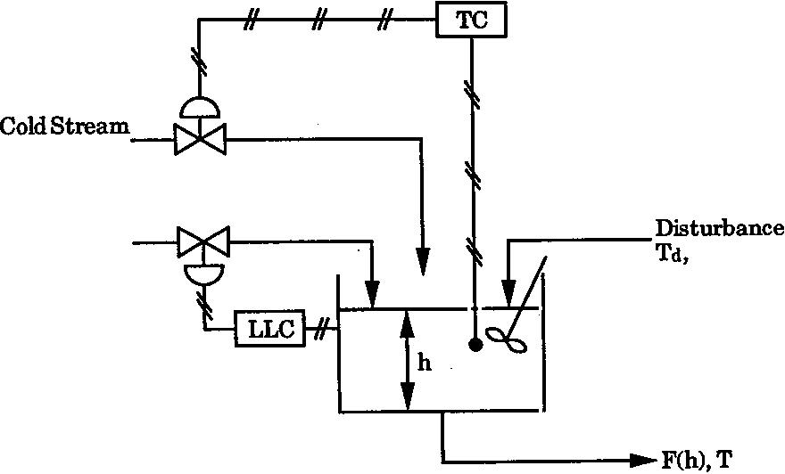
Input/Output Pairing
MIMO control can be configured in different ways depending on which input variable is paired with which output variable
TITO we have two such configurations:
Configuration 1 Configuration 2
u₁—y₁ u₁—y₂
u₂—y₂ u₂—y₁
Example: Stirred Mixing Tank two configurations
Hot stream to control liquid level
Cold stream to control liquid temperature
Hot stream to control liquid temperature
Cold stream to control liquid level
Process Control
Dr. Cai Wenjian

Slide 5
Interaction
A particular manipulated m_{i} will influence several outputs
Example: Stirred Mixing Tank, Hot stream flow rate paired with the level
Changes in hot stream flow rate affect both
  liquid level
  temperature.
Interaction:
one of the main problems for control of multivariable systems
Process Control
Dr. Cai Wenjian

Slide 6
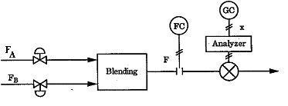
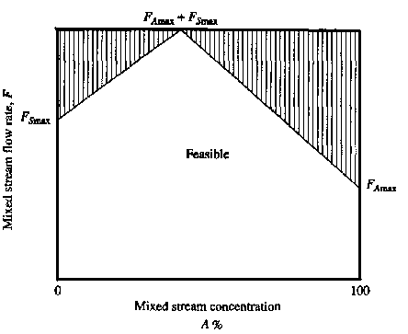


Operating Window
Operating window: range of possible steady‑state process values.
    Limited by Interactions.
Example: Blending process: MV
  production rate
  blended production composition.
Non interaction: operating window rectangular
Interaction: One MV influences the range of the other MV.
Process Control
Dr. Cai Wenjian

Slide 7


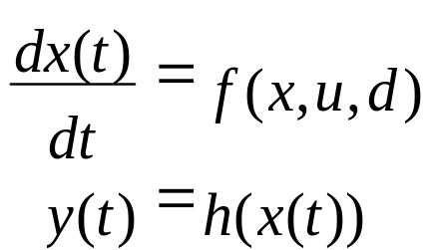
State-Space Model Form
Linear:
x: l-diml vector of state variables;
u: m-dim vector of control variables;
y: n-dim vector of output variables;
d: k-dim vector of disturb variables;
A, B, C, and Γ as appropriately dimensioned system matrices.
Nonlinear:
f(x, u, d), and h(x(t)) are vectors of nonlinear functions.
Process Control
Dr. Cai Wenjian

Slide 8

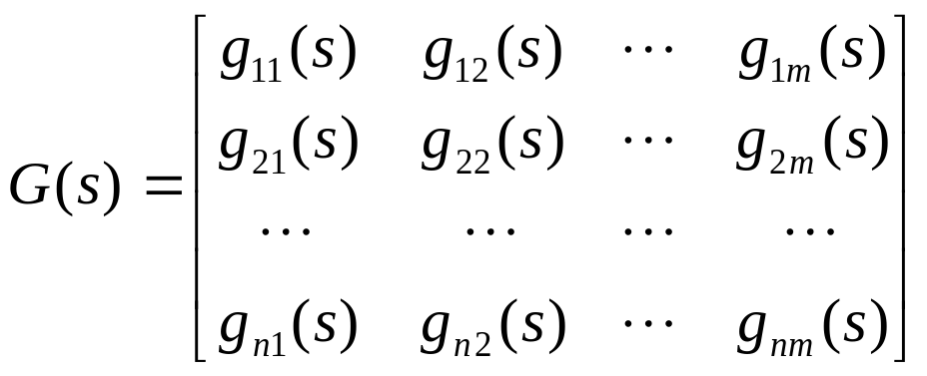
Transfer Function Model Form
The vector of input variables to output variables:
G(s)- System transfer function matrix with elements and each g_{ij}(s)
G_{d}(s)-Disturbance transfer function matrix
Process Control
Dr. Cai Wenjian

Slide 9
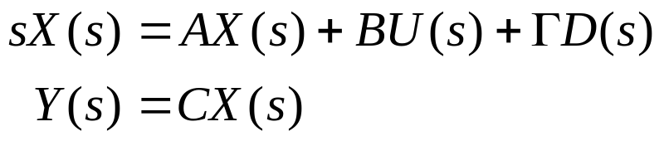
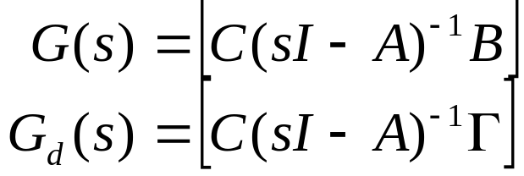
Relations between Model Forms
Taking Laplace transforms to state-space form
rearrange
resulting
Deducing state-space from transfer function model is not simple.
No realization is unique, many differential equations will yield the same transfer function matrix.
Process Control
Dr. Cai Wenjian

Slide 10
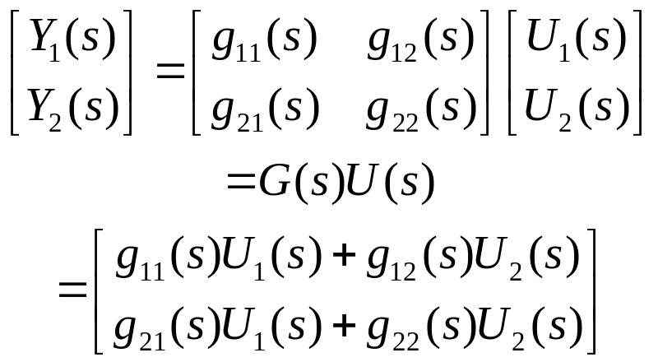
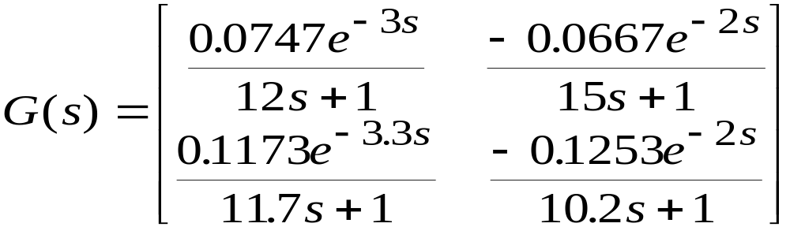
Distillation - Transfer Function Matrix
Relative magnitudes of gains
Relative magnitudes of
time delays
Relative magnitudes of
time constants
Process Control
Dr. Cai Wenjian

Slide 11

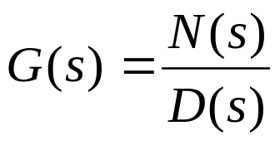
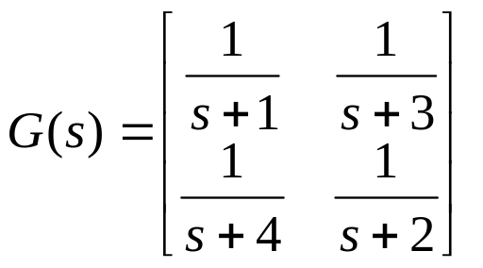
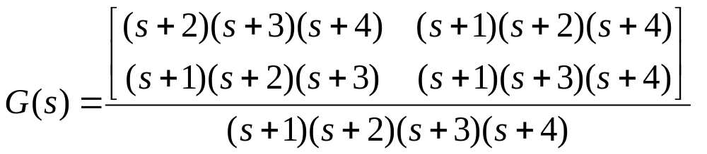


Multivariable System Poles
SISO:
MIMO: Poles are collection of all poles of individual transfer function.
Example:
The transfer function matrix has single poles at
Process Control
Dr. Cai Wenjian

Slide 12
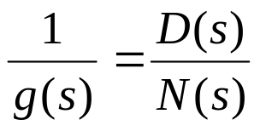
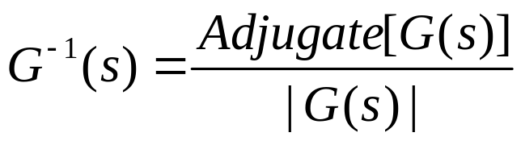

Multivariable System Zeros
SISO: (poles of 1/g(s)):
MIMO: poles of the inverse of the transfer function matrix G(s)
The roots of the equation:
are the zeros of the transfer function matrix G(s).
Process Control
Dr. Cai Wenjian

Slide 13
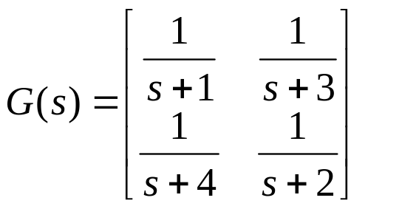
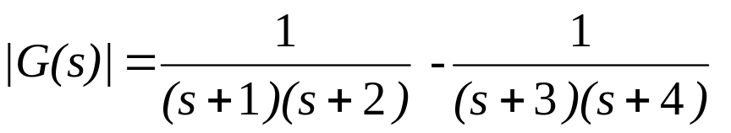
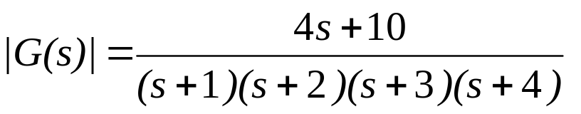
Example
Find the zero(s) of MIMO process with transfer function matrix:
The determinant of this transfer function matrix is obtained as
a single zero at s = -10/4.
Process Control
Dr. Cai Wenjian

Slide 14
Multivariable System Zeros
1. Finding zeros of a multivariable system is not straightforward, very difficult to find zero values by inspection alone
poles and zeros may be in the same location. Must ensure that there has been no pole-zero cancellation when forming the determinant.
For decentralized or sparse control when other loops are closed, stable (left half plane) or unstable (right half plane) zeros might be introduced into a control loop (zero crossing).
If an unstable zero is introduced, phase shift to the left in the frequency domain, reduce stability margin.
Process Control
Dr. Cai Wenjian

Slide 15

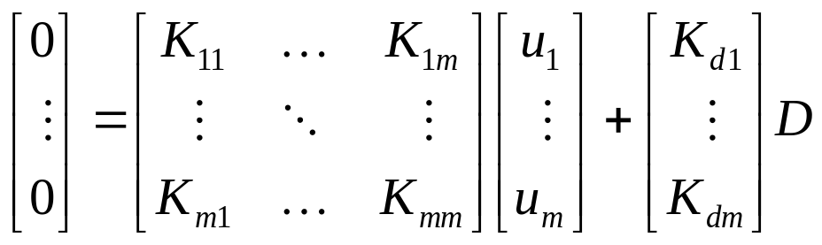
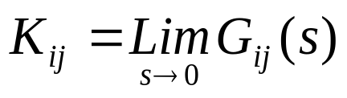
Controllability
Controllable: if the controlled variables can be maintained at their set points, in steady state, in spite of disturbances entering system.
State space model
Assume system begins at a steady state, the system is controllable
Controlled variables can be maintained at set points, by adjusting the specified MVs in step like disturbances.
The steady state can be determined by the final value theorem.
Process Control
Dr. Cai Wenjian

Slide 16
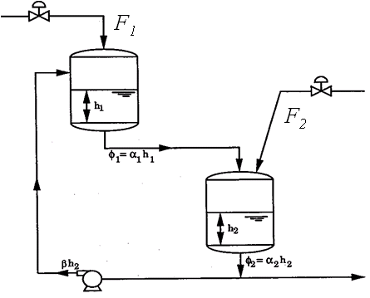
Controllability Example
Two-tank process: flow into Tanks 1 and 2 at F₁, and F₂, the outflow of each tank proportional to h₁ and h₂. The liquid leaving Tank 2 split into two with F, exiting, and R back to the first tank.
Both inlet streams, and the recycle pump in operation, controllable.
Off the recycle pump, F₂ at constant flow, F₁ is operational; Conditional controllable.
Off recycle pump, F₁ at constant, F₂ is operational. Uncontrollable.
Process Control
Dr. Cai Wenjian

Slide 17
Observability
Observable: if it is possible to determine a status of a variable from observation of the output over a finite time interval.
State space model
Example: The two-tank system:
Only the liquid level in one tank be measured;
The recycle loop is not in operation.
If measured is h₂, its value is influenced by h₁ though the Tank 1 outflow, h₁ can be extracted from h₂, and a process model. Observable
If measured is h₁, without the recycle loop in operation, there is no way to obtain anything about h₂ from h₁. Unobservable
Process Control
Dr. Cai Wenjian

Slide 18
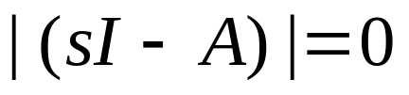
Stability
BIBO stability: A MIMO process is stable if and only if all the poles of the transfer function matrix have negative real parts; otherwise it is unstable.
In relation to the equivalent state-space form, the multivariable system poles resulting from evaluating the determinant:
Stability requires the roots of the equation all lie in the LHP. It is identical for stabilty in terms of its transfer function matrix or its state-space model.
Process Control
Dr. Cai Wenjian

Slide 19
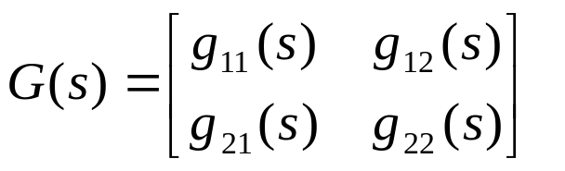
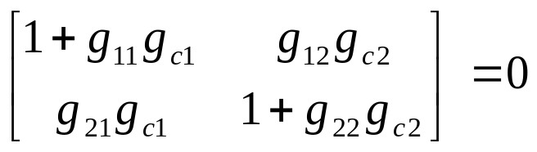
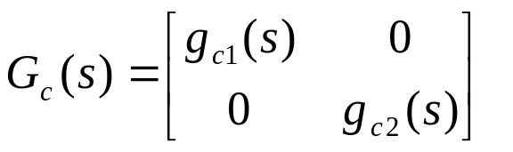


Stability Example
Characteristic equation
Evaluating determinant:
g₁₁ or g₂₂ is zero, individual loops considered independently for stability.
g₁₂ or g₂₁ (but not both) are zero, interactions exists among loops, no effect to stability condition.
Only Loop 1 or Loop 2 is closed, the system operating as a SISO system.
Process Control
Dr. Cai Wenjian

Slide 20
Example - Stability Region
Complete closed-loop stability for the MIMO problem depends on the tunings of both controllers
in this example - controller gains must be reduced
Individual Loops
Both Loops Closed
unstable region
Controller 2 gain
stable region
Controller 2 gain
Controller 1 gain
Controller 1 gain
Can we use steady-state information to predict instability?
Process Control
Dr. Cai Wenjian

Slide 21
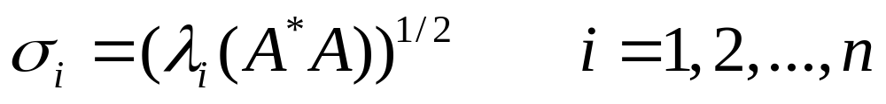
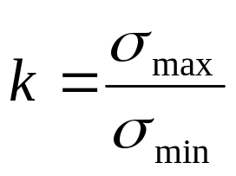
Singularity — Singular Values
Matrix is singular: determinant is zero,
The measure of the near singularity of a matrix can be found from the singular values of the matrix, defined as
Condition number: The ratio of the largest and smallest singular value
The condition number provides a reliable indication of the onset of singularity, or “ill-conditioning.”
Process Control
Dr. Cai Wenjian

Slide 22
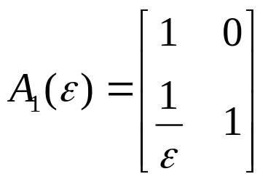
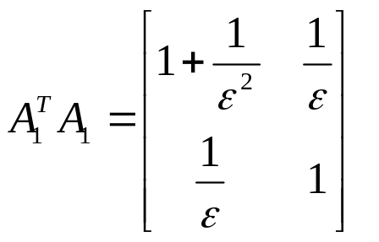
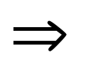
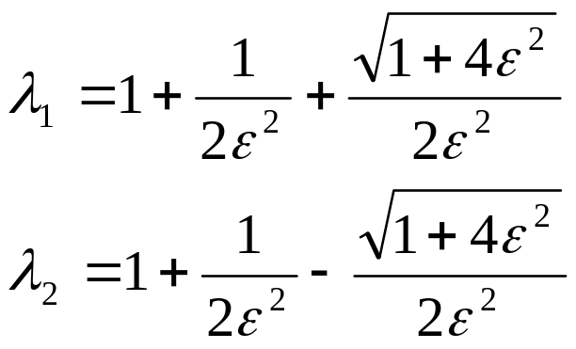
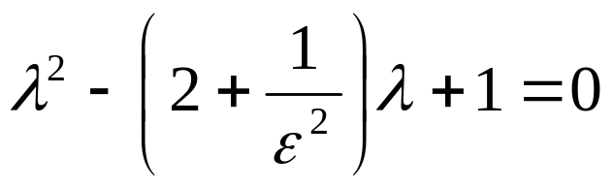
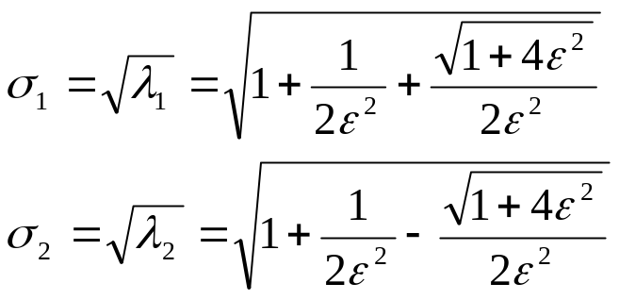
Example
The eigenvalues is obtained as the two roots of:
ε —>0, σ₁ —>∞, and σ₂—>1
The matrix is ill-conditioned
Difficult to check singularity from A_{1,} k provide important information for controller design
Process Control
Dr. Cai Wenjian

Slide 23
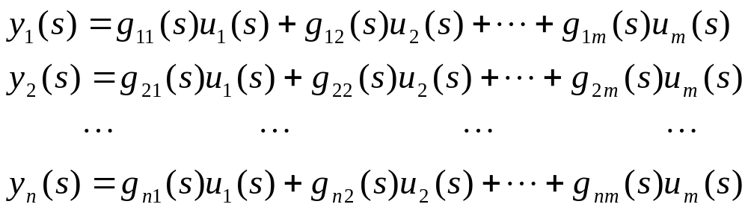

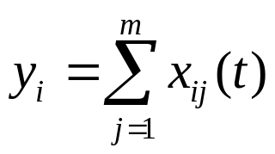

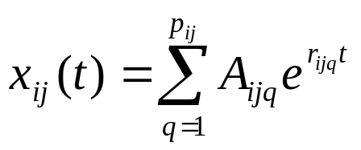
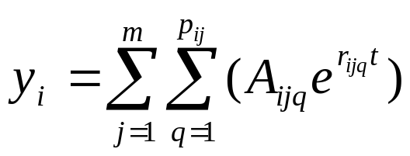
Dynamic Analysis: s-Domain
Multivariable system
or
Define x_{ij} as the product of the ijth transfer function element and the jth input, i.e.:
and
If g_{ij} (s) has p_{ij} poles, inverting to time domain:
A_{ijq}: coefficients,
r_{jjq}, q = 1, 2, ..., are roots of denominator polynomial of g_{ij} (s).
Process Control
Dr. Cai Wenjian

Slide 24
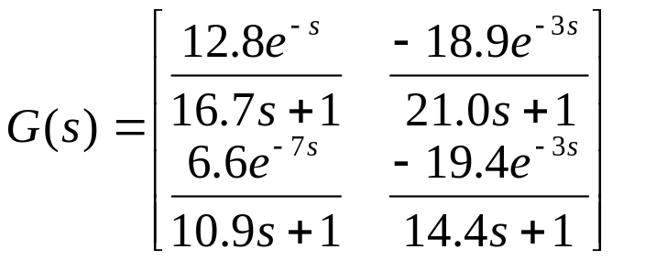
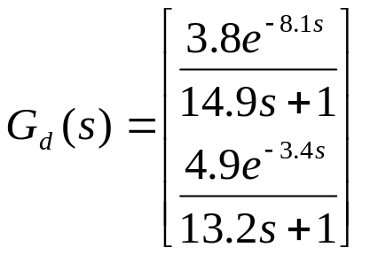
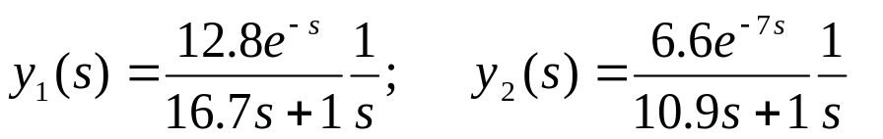
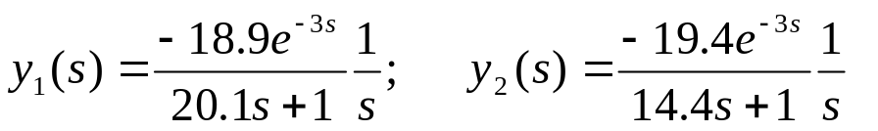
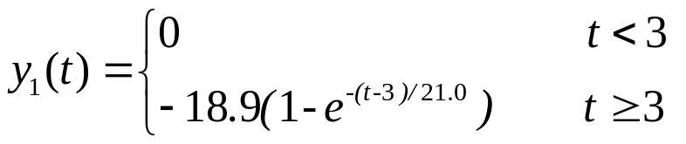
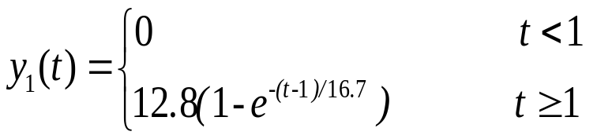
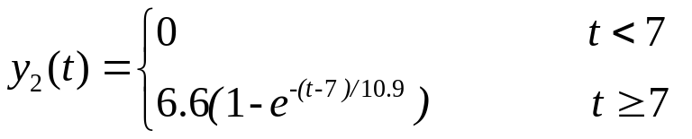
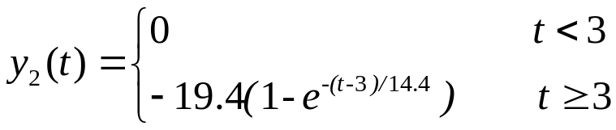
Example: Binary Distillation Column
u₁ = 1 and u₂ =0, then
u₂ = 1 and u₁ = 0,
Process Control
Dr. Cai Wenjian

